Slide 1

Knowledge Representation and Reasoning
Dr. Iftikhar Alam

Slide 2
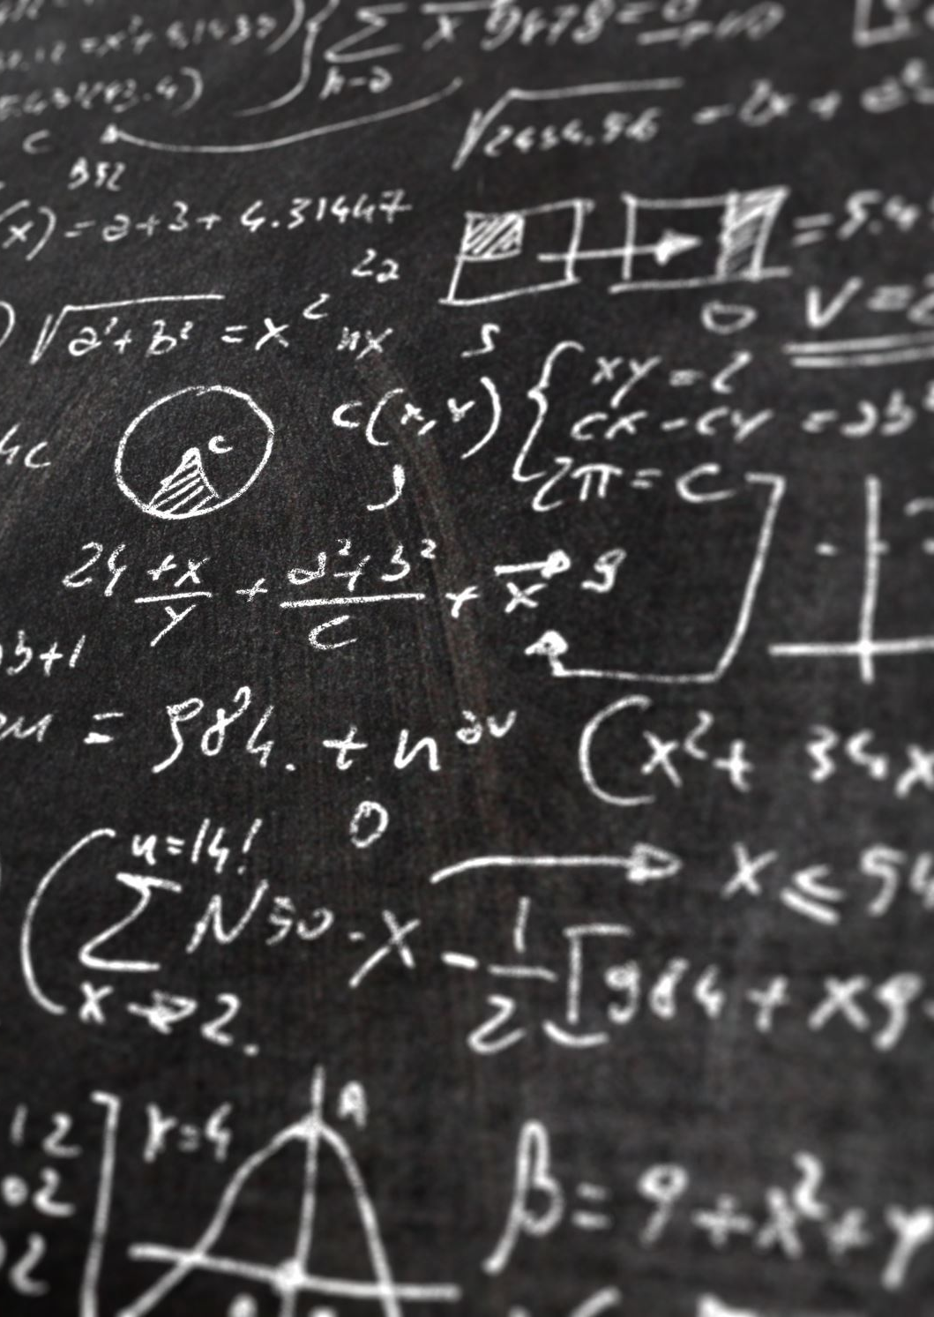
Schemes/Approaches
Prepositional logic (Prepositional calculus)
Predicate logic (Predicate Calculus)
Semantic Networks
Ontological approach
Knowledge Graph
Topic Maps
Frames
Scripts

Slide 3
Prepositional logic
Part-III Chapter 7, 8 (Russell)
Part-III Chapter 2, and 7 (Luger)

Slide 4
Logical Agents
In AI, knowledge-based agents use a process of reasoning over an internal representation of knowledge to decide what actions to take.
  Knowledge-based agents
    Central Components
      Knowledge base (set of sentences)
      Each sentence is expressed in a language called a knowledge representation language
      When the sentence is taken as being given without being derived from other sentences, we call it an axiom.
There must be a way to add new sentences to the knowledge base and a way to query what is known. The standard names for these operations are TELL and ASK, respectively. Both operations may involve inference—that is, deriving new sentences from old.

Slide 5
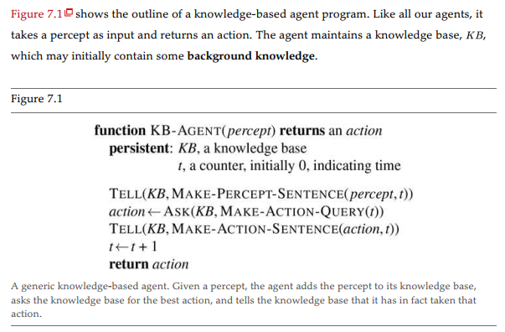
Knowledge base agent

Slide 6
Declarative vs Procedural
Declarative knowledge
  Fact based
  Static in nature
  Computer is an electronic device
Procedural knowledge
  How to perform, operate, proceed in certain environment
  How to calculate the percentage
  Etc.

Slide 7
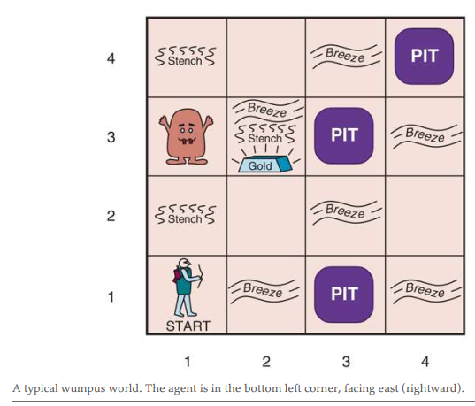
The Wumpus World

Slide 8
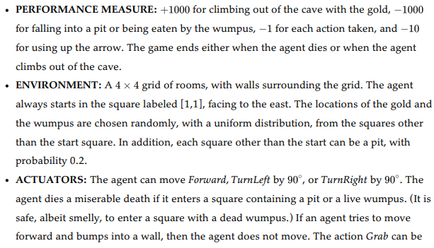
PEAS for Wumpus

Slide 9
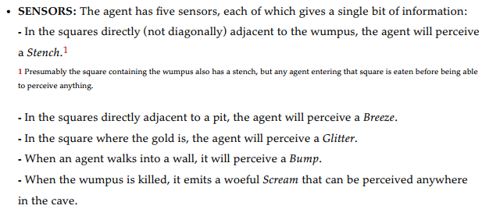
Cont….

Slide 10
Logic
A logic must also define the semantics, or meaning, of sentences. The semantics defines the
truth of each sentence with respect to each possible world. For example, the semantics for
arithmetic specifies that the sentence “ ” is true in a world where is 2 and is 2, but
false in a world where is 1 and is 1. In standard logics, every sentence must be either true
or false in each possible world—there is no “in between.”

Slide 11
Propositional Logic: A Very Simple Logic
Preposition is a statement of a fact.
  Example: Ali is a good boy. (Is Ali a goof boy?) is not a stamen of fact.
  3*3=12 ( is a statement ) but false
  Propositional symbols or variables
  A,B,C, P,Q,R…..
  Ali is a good boy. (P=Ali is a propositional variable)
  Ali is hardworking. (Q) is symbol.
  How to combine both (Ali is good and honest boy)
    Connective (^) (P^Q)

Slide 12

Con….
Connectives
AND (^)
OR (v)
→ (Implies) Conditional
←> (bi conditional)
Not
Some practice on truth table

Slide 13
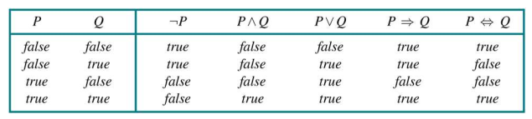
Cont…

Slide 14
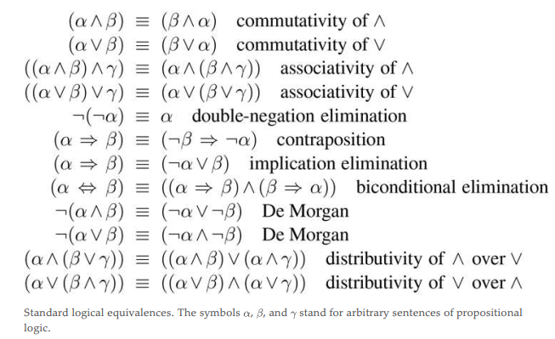
Prepositional theorems

Slide 15
End of lecture
Next is First Order Logic (Predicate Logic)
An extended version of the Prepositional logic

